Slide 1
SARCASTIC NEWS HEADLine DETECTION
SHASHANK SHIVAKUMAR NAMRATHA PRAKASH

Slide 2
OBJECTIVE
Develop a nuanced NLP model capable of accurately classifying news headlines as sarcastic or non-sarcastic.
Utilize a mix of classical ML algorithms (Naive Bayes, MLP, LR) and advanced neural networks (LSTM, BERT, Roberta) for effective sarcasm detection.
Implement transformer-based models, specifically the T5-small-headline-generator, to create summaries that can potentially mimic sarcasm in news headlines.

Slide 3
DATA Source
Dataset Selection: 'News Headlines Dataset For Sarcasm Detection' from Kaggle.
Volume & Sources:
Contains 55,328 headlines with articles.
Compiled from two distinct websites to reduce noise and ambiguity.
Composition & Reliability:
Sarcastic headlines from TheOnion's satirical news sections.
Non-sarcastic headlines from HuffPost for serious news content.
Dataset Attributes:
is_sarcastic: Binary indicator (1 for sarcastic, 0 for non-sarcastic).
headline: Text of the news headline.
Web Scraping for sarcastic news from TheOnion website.

Slide 4
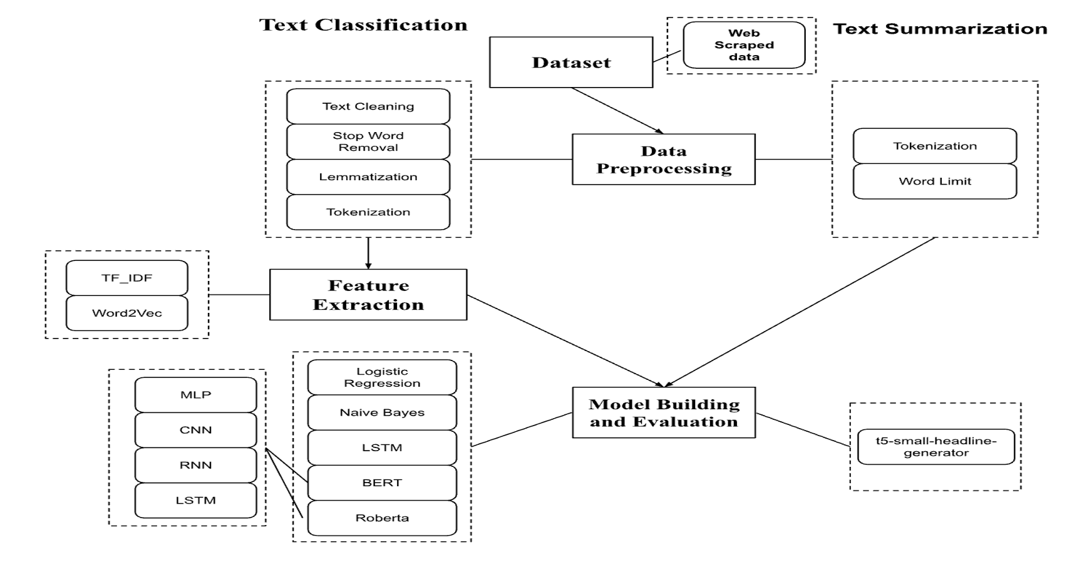

Slide 5
PReprocessing
Data Cleaning: Applied regular expressions to eliminate numbers, punctuations, and extraneous characters; transformed text to lowercase for uniformity.
Stop Words Removal: Utilized NLTK package to filter out stop words, streamlining the dataset for more efficient processing.
Text Normalization: Conducted lemmatization to consolidate word variants to their dictionary form, enhancing the consistency of the dataset.

Slide 6
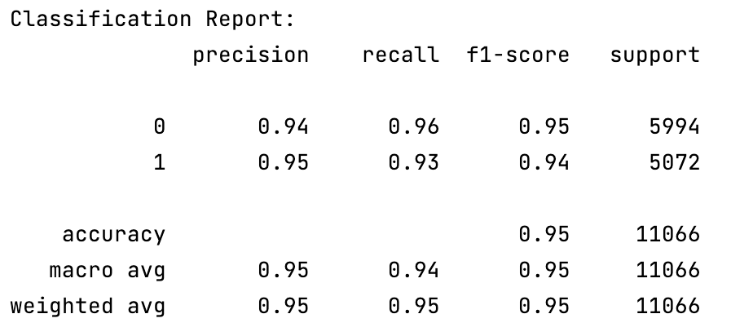
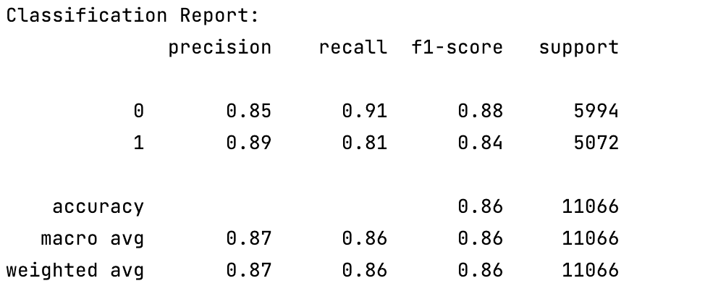
Classification Classic models
Used unprocessed data for baseline model performance.
Segregated data into training and testing sets without preprocessing.
Transformed text into feature vectors using TF IDF.
Evaluated Logistic Regression and Naive Bayes with scikit-learn.
Model results picture

Slide 7
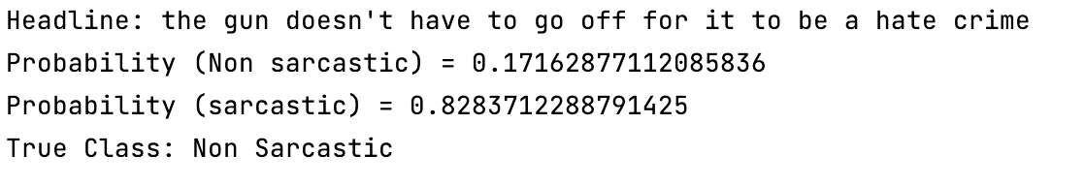
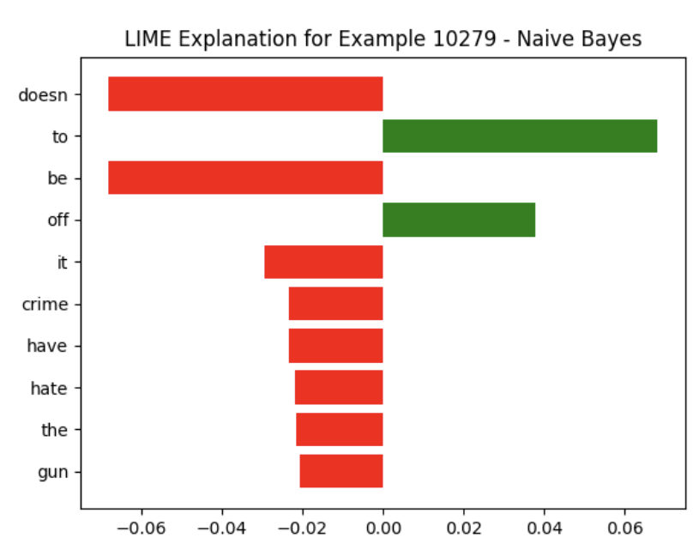
Model Explainability : LIME
Uses LIME to shed light on the predictions made by complex models.
Words 'doesn't', 'it', 'crime', 'have', 'hate', 'gun' negatively influence the prediction.
Words 'be' and 'off' positively affect the model's outcome.
Bar length indicates the magnitude of each word's impact on the classification.
LIME clarifies model reasoning, revealing keywords that lead to the Naive Bayes decision.

Slide 8
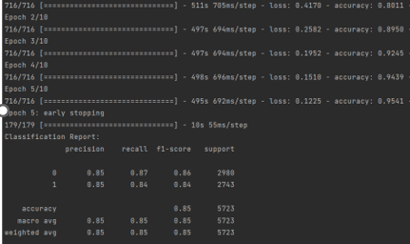
Classification lstm
Training accuracy progressed from 80.11% to 95.41% across five epochs.
Validation accuracy peaked at 86.13%, reflecting high model performance.
The model demonstrated a consistent decrease in loss, showing effective learning.
Early stopping after the 5th epoch suggests the model's robustness in generalization without overfitting.

Slide 9
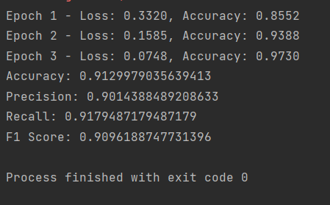
CLASSIFICATION BERT
Training showcased consistent improvement, with constant decrease in training loss.
The model achieved an impressive accuracy of 97.30% on training and 91.47% on validation data.

Slide 10
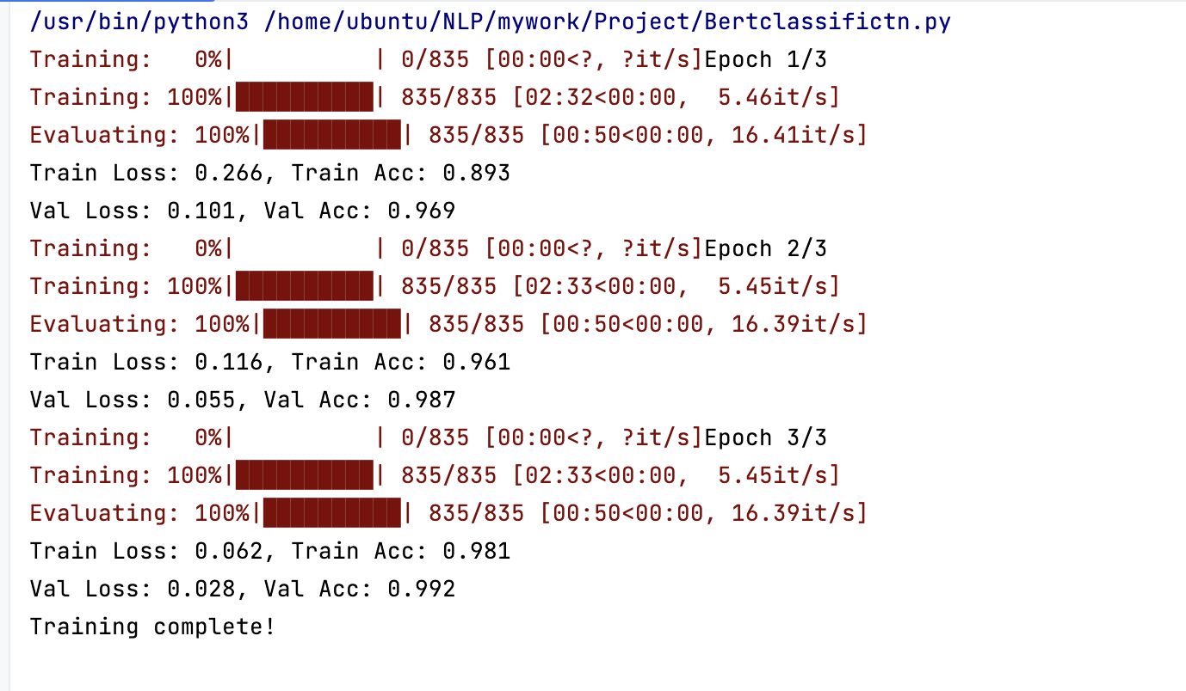
CLASSIFICATION Transformers - BERT + LSTM
Training accuracy improved from 89.3% to 98.1% over three epochs.
Validation accuracy increased from 96.9% to 99.2%.
Both training and validation losses significantly decreased, indicating effective learning.
High validation accuracy suggests strong model generalization without overfitting.

Slide 11
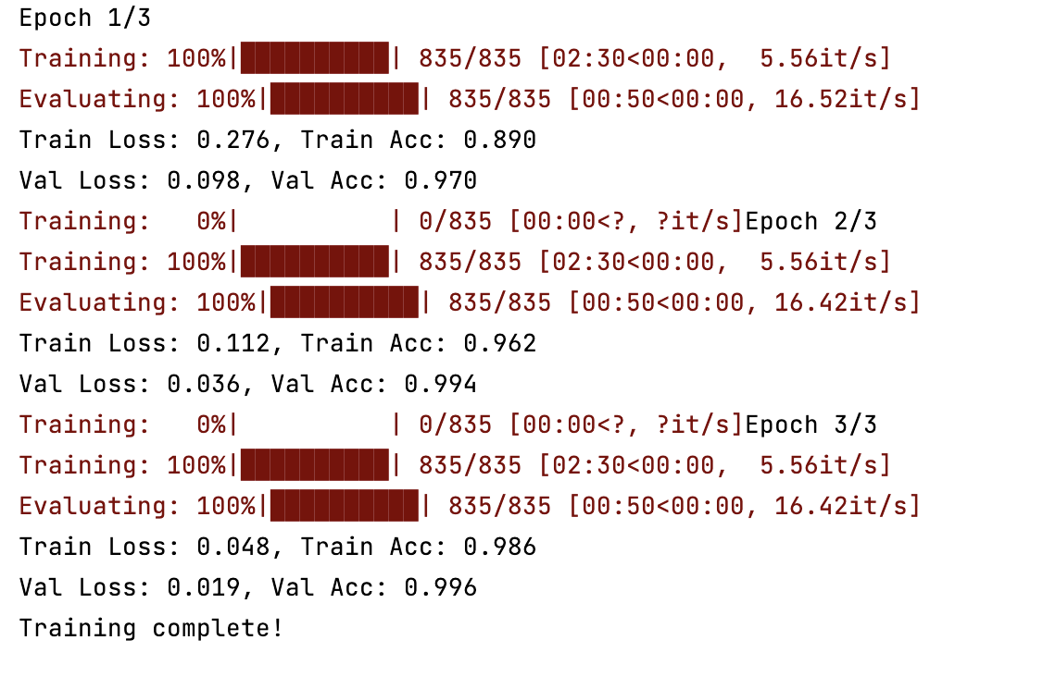
CLASSIFICATION Transformers - BERT + MLP
BERT+MLP reached 99.6% validation accuracy.
Consistent gains over three epochs.
Well-tuned model with reduced losses.

Slide 12
CLASSIFICATION
Model | Accuracy | Epochs | Max Length | Learning Rate | Batch Size | Optimizer
Naive Bayes | 0.86
Logistic Regression | 0.94
LSTM | 0.95 | 4 | 120 |  |  | Adam
CNN | 0.97 | 4 | 120 |  |  | Adam
BERT | 0.97 | 3 | 120 | 2e-5 | 32 | AdamW
BERT + LSTM | 0.98 | 3 | 128 | 2e-6 | 32 | AdamW
BERT + CNN | 0.82 | 5 | 128 | 2e-5 | 32 | AdamW
BERT+MLP | 0.98 | 3 | 128 | 5e-5 | 32 | AdamW
Notes:
Begin with an introduction, "Let's look into the parameters that play a critical role in the training and performance of our project models."
"We'll cover what epochs, max length, learning rate, batch size, and optimizer mean and how they impact our model's learning process."
—"More epochs mean the model has more opportunities to learn and adjust its weights. However, too many epochs can lead to overfitting
Setting the right max length is crucial for capturing sufficient context without wasting computational resources on padding"
—, "A smaller learning rate means the model updates its weights more slowly, which can be good for fine-tuning but too small can make training inefficient. A larger rate speeds up training but can overshoot the optimal values."
"A smaller batch size provides a more granular update to weights but can be noisy and take longer to train, while a larger batch size can be more stable and efficient but requires more memory."
"Adam and AdamW are advanced optimizers that adapt the learning rate for each weight of the model. AdamW is a variant of Adam with better weight regularization."
now we compare the performance of several machine learning models on our text classification task."
"First, we have our baseline models. Naive Bayes showed an accuracy of 86%, while Logistic Regression performed better with 94%."
"Next, The LSTM achieved 95% accuracy over 4 epochs, and the CNN surpassed it slightly with 97% accuracy,
"Moving to the more advanced transformer models, BERT alone reached 97% accuracy
"Combining BERT with LSTM or MLP boosted the accuracy to 98%, but interestingly, BERT with CNN decreased to 82% despite more epochs and the same learning rate as BERT alone."
These results show us that while transformer models have high potential, their performance is heavily dependent on the right combination of hyperparameters and architecture."
In conclusion, our best-performing model was the BERT+MLP, with an accuracy of 98% over just 3 epochs. This indicates a well-tuned model suitable for our classification needs."
epoch s,learning rate or sb change kita to
Suppose you have the BERT+MLP model with an accuracy of 0.98, trained over 3 epochs with a learning rate of 5e-5, a batch size of 32, and using the AdamW optimizer.
If you increase the epochs to 5, the model might start overfitting, leading to a potentially higher training accuracy but possibly lower validation accuracy.
If you increase the learning rate to 1e-4, the model might converge faster, but it could start to overshoot the optimal solution, which could reduce accuracy.
If you increase the batch size to 64, the training might become faster, but the model might not generalize as well due to convergence to sharper minima.
If you switch the optimizer from AdamW to SGD, you might see a slower convergence and potentially worse performance unless you also adjust the learning rate and introduce momentum.

Slide 13
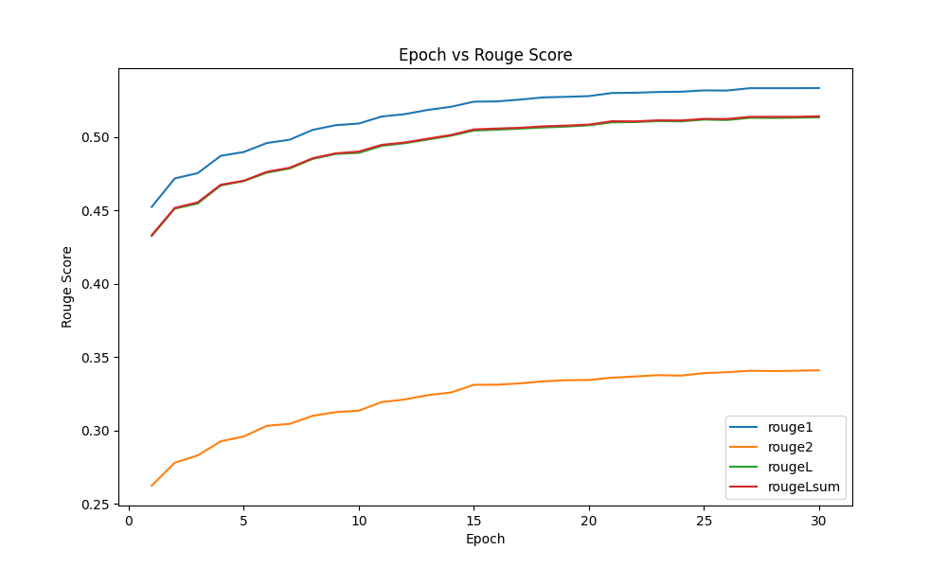
summarization
Model: t5-small-headline-generator (Text-to-Text Transfer Transformer)
Evolution Metric: ROUGE scores provide insights into the quality of the generated summaries concerning the ground truth.
Notes:
The T5 (Text-to-Text Transfer Transformer) is a transformer-based neural network architecture designed for a unified text-to-text approach. Particularly, we have used the pre-trained t5-small-headline-generator model and trained it on our set of training data to generate sarcastic headlines.
To evaluate our model performance, we have used ROUGE (Recall-Oriented Understudy for Gisting Evaluation) metrics to evaluate how well the generated summary captures the key information present in the reference summary or document.
ROUGE-1 measures unigram overlap between the generated text and reference text,
ROUGE-2 evaluates bigram,
ROUGE-L assesses the longest common subsequence,
and ROUGE-Lsum considers unigrams, bigrams, and longest common subsequence in automatic text summarization evaluation.
A ROUGE score of over 0.5 means that the model is capturing most of the required features.
Here we have trained our model over 30 epochs and most of the ROUGE scores are over 0.5. This suggests that the generated summaries are capturing the content and context well, but the ROUGE-2 is relatively lower. ROUGE-2 focuses on bigrams, which involve the structure and ordering of words. So one potential explanation for this is that the generated summaries preserve content but rearrange or rephrase words.

Slide 14
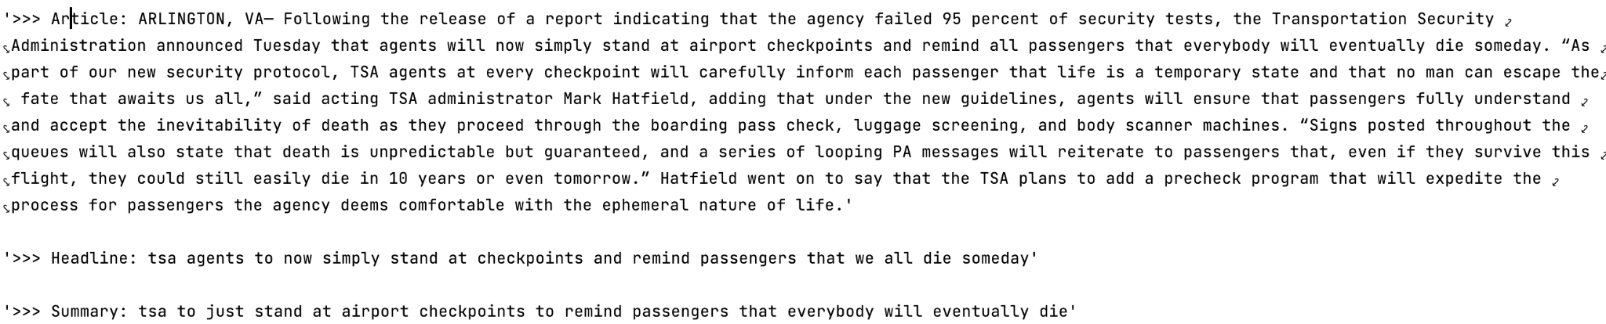

SUMMARIZATION-Prediction
Model Explainability using SHAP (SHapley Additive exPlanations)
Notes:
Zxzxsxdasd

Slide 15
conclusion
The integration of BERT with other neural network architectures has proven highly effective for sarcasm detection, surpassing traditional models and even outperforming other advanced neural network-based classifiers.
The text summarization model achieved commendable ROUGE scores, reflecting its proficiency in generating concise and meaningful summaries.

Slide 16
DEMO
THANK YOU

